Slide 1
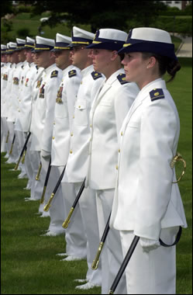
Duty
United States Coast Guard
Estate Planning Overview
Family
Country
By: Carletha Windom
Work-Life Base Cleveland Personal Financial Manager (PFM)

Slide 2
Disclaimer
Agenda
It's important to note that the information provided in this informational briefing is intended to provide education and awareness to inform service members, civilians, and their families about their personal estate planning considerations. However, it's crucial to understand that this is an informational briefing only, and it is not designed to replace the expertise of a licensed attorney. Therefore, it is highly recommended that service members, civilians, and their families seek legal counsel at the nearest installation Legal Assistance Office staff or Legal representative of your choice.

Slide 3
Historical Note
Agenda
Since 2008, the third week of October has been recognized as National Estate Planning Awareness Week (NEPAW) thanks to the hard work and dedication of the National Association of Estate Planners & Council (NAEPC).

Slide 4
AGENDA
Agenda
What is Estate Planning? How often do we think about it?
What does an Estate Plan include?
Why is Estate Planning important?
Estate Planning thoughts and Resources for your journey?

Slide 5
What is Estate Planning?
Agenda
Defining Estate Planning: as a process that involves developing strategies for the management and distribution of personal assets such as real estate, investments, Social Security, cash, life insurance, or business interests. This is typically done before incapacitation or death and is essential for ensuring that one's assets are handled according to their wishes and in the best interest of their beneficiaries.
Estate Planning: can be an emotional and difficult process, but it is one that is essential for ensuring that your loved ones are taken care of in the event of your absence. By engaging in this process, you can be confident that your legacy will reflect your values and that your family members will be provided for in a manner that honors your memory.
Estate Planning is a Plan: that gives you peace of mind by guaranteeing that your affairs are in order and that your loved ones are provided for in accordance with your wishes.

Slide 6
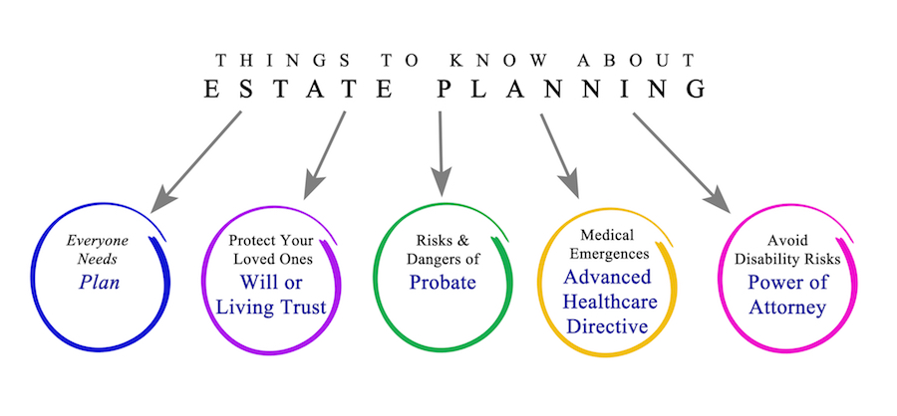
What does Estate Planning include?
Agenda
Deciding Beneficiaries
Talking with family about your wishes
Survivor's Benefits (SBP)
Burial and Funeral arrangements
Preparing a Last will and testament
Living Will (advanced medical directives)
Long-term care insurance
Servicemembers Group Life Insurance (SGLI)
Power of attorney
Thrift Savings Plan (TSP)
Federal Employees Group Life Insurance Program
What will happen to your property? Who cares for your children?
Who oversees your finances and health care options when you cannot?

Slide 7
Why is Estate Planning Important?
Agenda
Estate planning provides peace of mind and can save you and your loved one's time and money in the long run. By having a will, you can ensure that your wishes are followed and that your children and loved ones are cared for by the person or people you trust. Don't wait to start your estate planning process and secure your family's future today! It’s free for military members. Schedule an appointment with your installation's legal assistance office; it is a great way to start your estate planning process.
It’s not just for rich people! That’s a myth!
Start by creating a Will and Living Medical Directive (it’s free for military and retirees). That process will force you to connect with your assets and values. You can make updates as you journey through life.
Please think through who you want as beneficiaries and executors of your disposition.
Determine your goals for your future. Make a PLAN!!!!
Understand yourself and stay in tune with your situation.

Slide 8
Financial Readiness Resources for Estate Planning
Agenda
https://finred.usalearning.gov/Planning/EstatePlanningOverview
https://www.youtube.com/watch?v=7WmIzSmXeew&feature=youtu.be
https://finred.usalearning.gov/Planning
REMEMBER: You need to PROTECT yourself as you SERVE your nation and BUILD your LIFE!!!
THANK YOU FOR ATTENDING

